Slide 1
A Study of Oracle Systems for the QTUM blockchain eco-system – ‘Oracle ²’
By
George John Chavady
Under the guidance of – Prof. Donal O’ Mahony

Slide 2
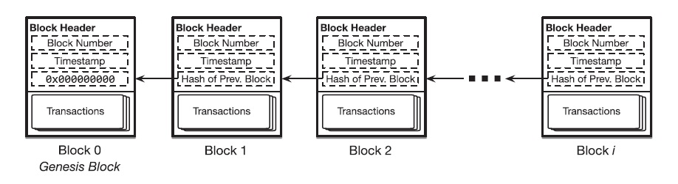
Blockchain
Decentralized and immutable platform
Technology – peer-to-peer network, distributed ledger, hashing
The distributed ledger is an append-only log.
The changes in the state of the blockchain are recorded as transactions and gathered into blocks.
E.g., Bitcoin, Ethereum

Slide 3

Bitcoin
Blockchain for the bitcoin cryptocurrency
UTXO model
Proof of Work algorithm
Merkle trees used to verify the authenticity of a transaction.

Slide 4
UTXO
Each transaction spends output from prior transactions and generates new outputs that can be spent by transactions in the future.
Unspent transactions are kept in each fully-synchronized node, and therefore this model is named “UTXO”
Proof-of-Work
PoW involves calculation of a random value called a nonce, such that a cryptographic hash of the block’s contents, including the numerical value of the nonce, falls below an upper threshold ‘t’.
Notes:
Let’s take a look at a simplified example of how the UTXO model works in Bitcoin transactions:
1. Alice gains 12.5 bitcoins through mining. Alice’s wallet is associated with one UTXO record of 12.5 bitcoins.
2. Alice wants to give Bob 1 bitcoin. Alice’s wallet first unlocks her UTXO of 12.5 bitcoins and uses this whole 12.5 bitcoins as input to the transaction. This transaction sends 1 bitcoin to Bob’s address and the reminder of 11.5 bitcoins is sent back to Alice in the form of a new UTXO to a newly-created address (owned by Alice).
3. Say there was another UTXO of 2 bitcoins associated with Bob prior to step 2, Bob’s wallet now shows that his balance is 3 bitcoins. Bob’s wallet now keeps track of two UTXOs: one from before and another from the transaction in step 2. Each UTXO needs to be unlocked if Bob wishes to spend them.

Slide 5
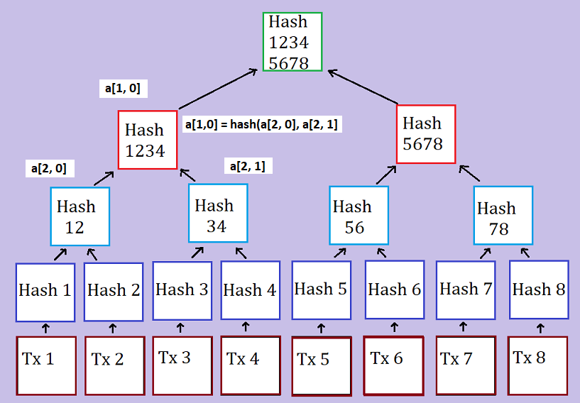
Merkle Tree
Represents a block in the chain
Uses the concept of hashing
Notes:
Each transaction present in the block has a hash; all converge to the root hash

Slide 6

Ethereum
Turing complete blockchain
Accounts/balance model
Proof-of-work algorithm
Smart contract creation
Notes:
Turing Complete – execute code of unbounded complexity
Accounts model – similar to a debit card transaction
Here is a simplified example of how this model works in Ethereum:
1. Alice gains 5 ethers through mining. It is recorded in the system that Alice has 5 ethers.
2. Alice wants to give Bob 1 ether, so the system will first deduct 1 ether from Alice’s account, so Alice now has 4 ethers.
3. The system then increases Bob’s account by 1 ether. The system knows that Bob has 2 ethers to begin with, therefore Bob’s balance is increased to 3 ethers.
Uses a variant of the Merkle tree

Slide 7
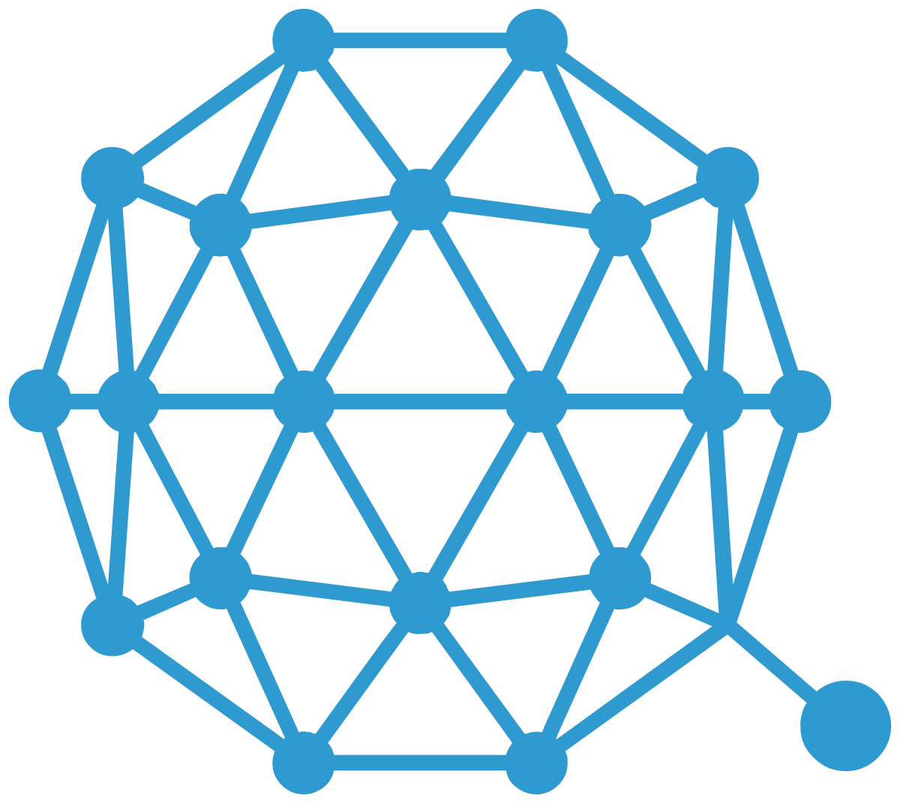
Qtum
Turing complete blockchain that uses the EVM
UTXO model
Proof-of-stake algorithm
Account abstraction layer
Decentralised Governance Protocol (DGP)
Notes:
The Account Abstraction Layer translates the UTXO-based model to an account-based interface for the EVM
UTXO model ; Scalability — Since it is possible to process multiple UTXOs at the same time, it enables parallel transaction processing.
Decentralised Governance Protocol (DGP) that allows QTUM token holders to participate in the voting and negotiation of the upgrade and iteration of the blockchain network

Slide 8
Blockchain Oracles
Used to supply data on-chain, since smart contracts cannot call the outside world.
Centralized and decentralized oracles
Human oracles, software/hardware
Consensus mechanisms for decentralized oracles. E.g., k out of n oracles
Notes:
E.g., horse race betting, smart contract to transfer funds to winners, event takes place, data that the nth horse has won the race needs to be passed on chain – done using the implementation of oracles

Slide 9
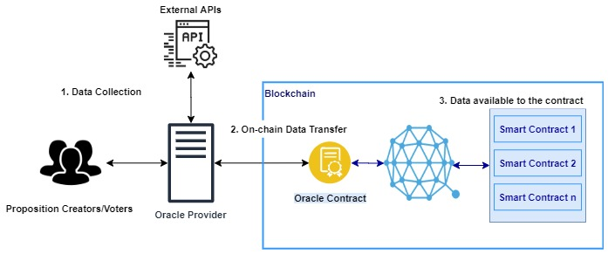
Blockchain Oracles
Notes:
E.g., horse race betting, smart contract to transfer funds to winners, event takes place, data that the nth horse has won the race needs to be passed on chain – done using the implementation of oracles

Slide 10
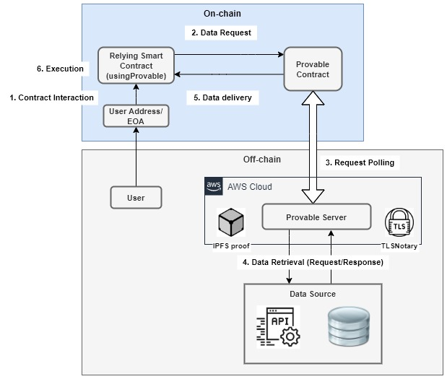
A centralized oracle - Provable
Notes:
E.g., horse race betting, smart contract to transfer funds to winners, event takes place, data that the nth horse has won the race needs to be passed on chain – done using the implementation of oracles

Slide 11
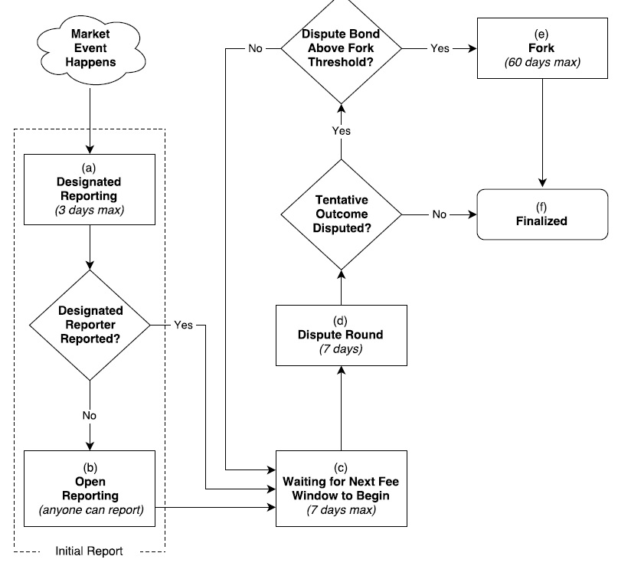
A decentralized oracle - Augur
Notes:
E.g., horse race betting, smart contract to transfer funds to winners, event takes place, data that the nth horse has won the race needs to be passed on chain – done using the implementation of oracles

Slide 12
Blockchain Oracles
Platform | Oracles | Consensus | Trust Model / features | Data Source(s) | Latency | Types of Oracles
Provable | single | N/A | TLS Notary, IPFS multihash | single | low | Provable Contract
TownCrier | single | N/A | Intel SGX, proofs | single | low | TownCrier Contract
Corda | single | N/A | Intel SGX | single | low | Corda code
MS Bletchley | multiple | N/A | Secure Container, Intel SGX | multiple | low | Off-chain code
Astrea | multiple | Voting/ Certification | Reward Pools, Penalties, | multiple | high | Certifiers/ Voters
ChainLink | multiple | n-of-k multi-signature | Off-chain aggregation, Reputation | multiple | high | Reporters
Augur | multiple | Voting | Reputation, Dispute windows, Forks | multiple | high | Voters
Gnosis | multiple | Voting | Centralized oracle, Ultimate oracle | multiple | high | Voters
Notes:
E.g., horse race betting, smart contract to transfer funds to winners, event takes place, data that the nth horse has won the race needs to be passed on chain – done using the implementation of oracles

Slide 13
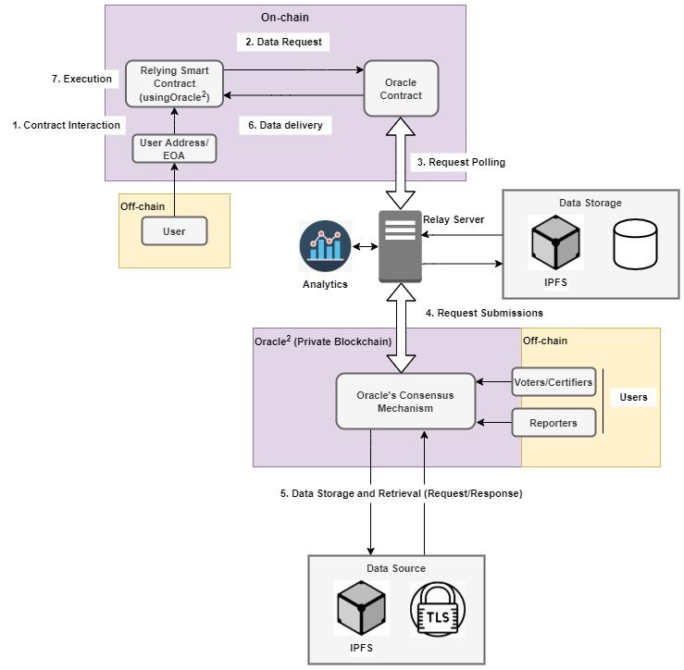
Oracle ² – Architecture
Notes:
E.g., horse race betting, smart contract to transfer funds to winners, event takes place, data that the nth horse has won the race needs to be passed on chain – done using the implementation of oracles

Slide 14
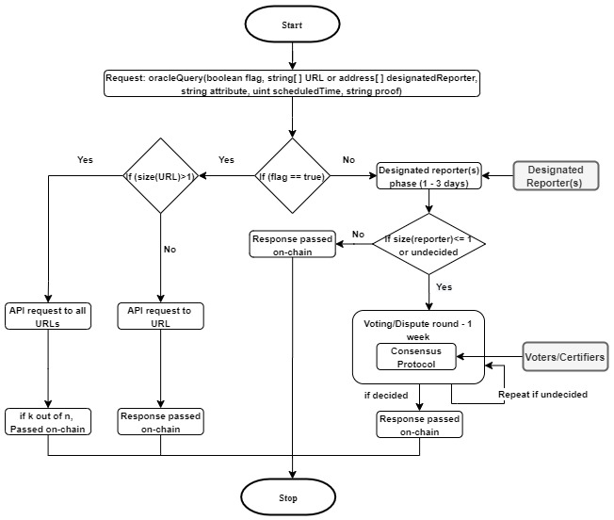
Oracle ² - Workflow
Notes:
E.g., horse race betting, smart contract to transfer funds to winners, event takes place, data that the nth horse has won the race needs to be passed on chain – done using the implementation of oracles

Slide 15
Innovation
Flexibility
Turn-around Time
Private blockchain
Qtum Tokens
Notes:
Flexibility - Our oracle makes it possible for oracle contracts to choose between a centralized and a decentralized service.
Turn-around Time - Together with flexibility comes an opportunity to improve the turn-around time of responses to requests. Also, the techniques of micro-decentralization and macro-decentralization helps reduce the response time by making it possible for multiple reporters to submit data during the designated reporter phase, to reach consensus
Private Blockchain – saves costs; transactions on a public blockchain and computation become costly
Qtum Blockchain? – helps with token creation; which can be used to stake deposits during voting and certification.

Slide 16
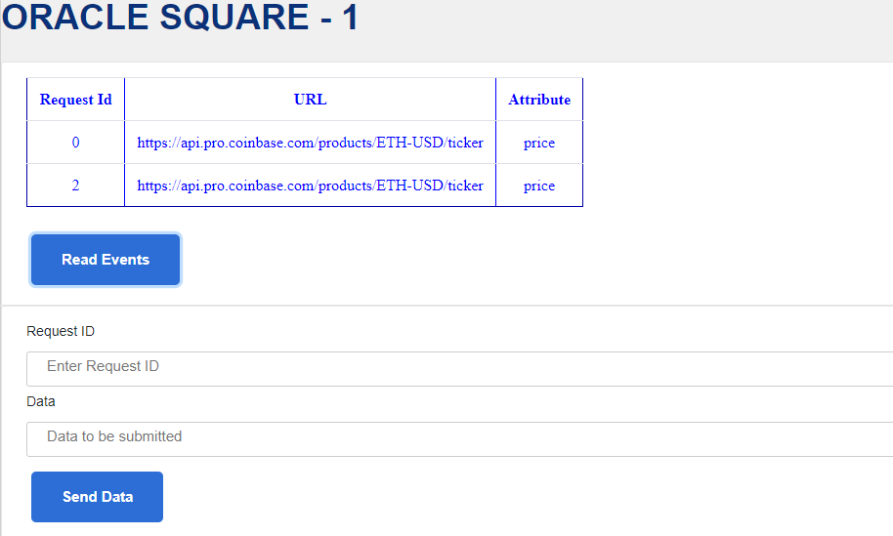
Implementation
Notes:
Flexibility - Our oracle makes it possible for oracle contracts to choose between a centralized and a decentralized service.
Turn-around Time - Together with flexibility comes an opportunity to improve the turn-around time of responses to requests. Also, the techniques of micro-decentralization and macro-decentralization helps reduce the response time by making it possible for multiple reporters to submit data during the designated reporter phase, to reach consensus
Private Blockchain – saves costs; transactions on a public blockchain and computation become costly
Qtum Blockchain? – helps with token creation; which can be used to stake deposits during voting and certification.

Slide 17
Why the Qtum blockchain?
UTXO Model
Account Abstraction Layer
Decentralized Governance Protocol (DGP)
Token Creation
Notes:
Flexibility - Our oracle makes it possible for oracle contracts to choose between a centralized and a decentralized service.
Turn-around Time - Together with flexibility comes an opportunity to improve the turn-around time of responses to requests. Also, the techniques of micro-decentralization and macro-decentralization helps reduce the response time by making it possible for multiple reporters to submit data during the designated reporter phase, to reach consensus
Private Blockchain – saves costs; transactions on a public blockchain and computation become costly
Qtum Blockchain? – helps with token creation; which can be used to stake deposits during voting and certification.

